Slide 1
Multidimensional Arrays In Java
momedaram

Slide 2
Types of Arrays:
Arrays are generally categorized into two types
Single dimensional arrays
Multi dimensional arrays(2D, 3D,……)
single dimensional array represents a row or column of elements.
int[] marks = {90,35,78,89,95,100};
if an array contains references to other array objects ,these arrays are called multidimensional arrays.

Slide 3



2D arrays, commonly known as, matrices.
89 70 38 42 50
100 77 48
49 77
99 77 50
99 88. 50.
Multidimensional arrays In java are implemented as array of arrays approach but not matrix form.
The main advantage of this approach is to improve memory utilization.

Slide 4
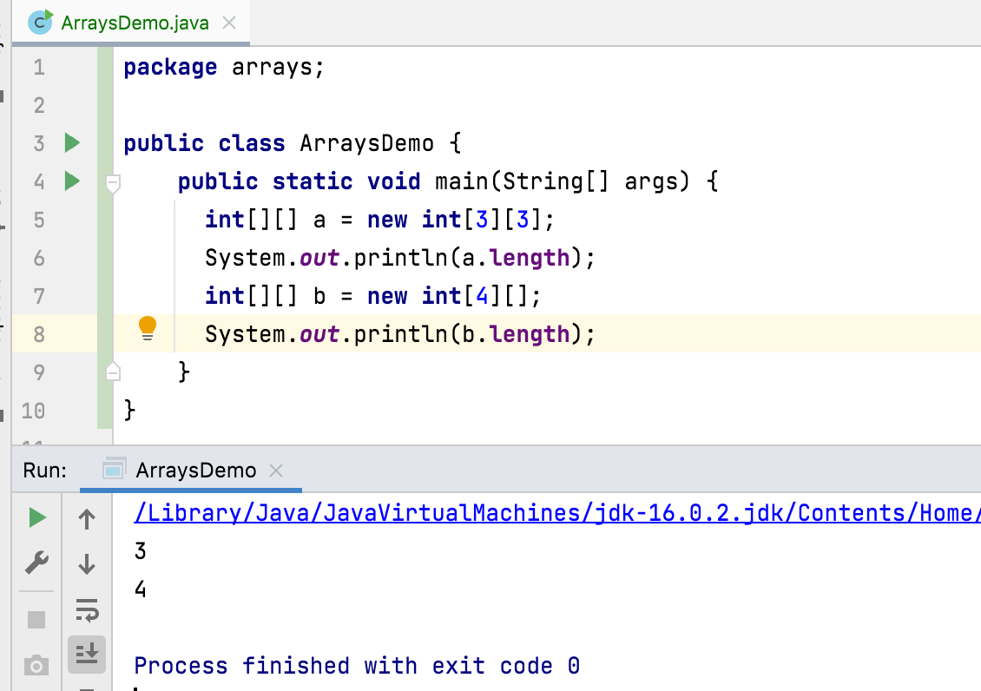
Two-Dimensional Array :
Two dimensional array is an array containing references of one dimensional arrays.
int[][] a = new int[3][3]; int[][] b = new int[4][];

Slide 5
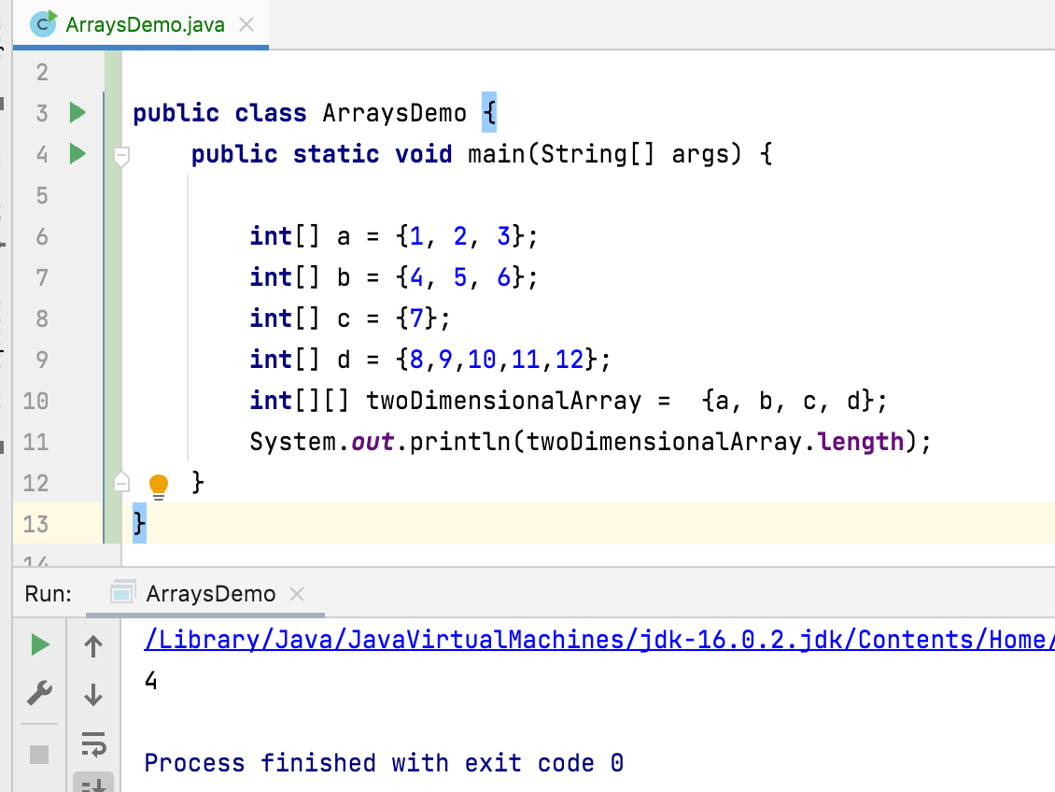

Slide 6
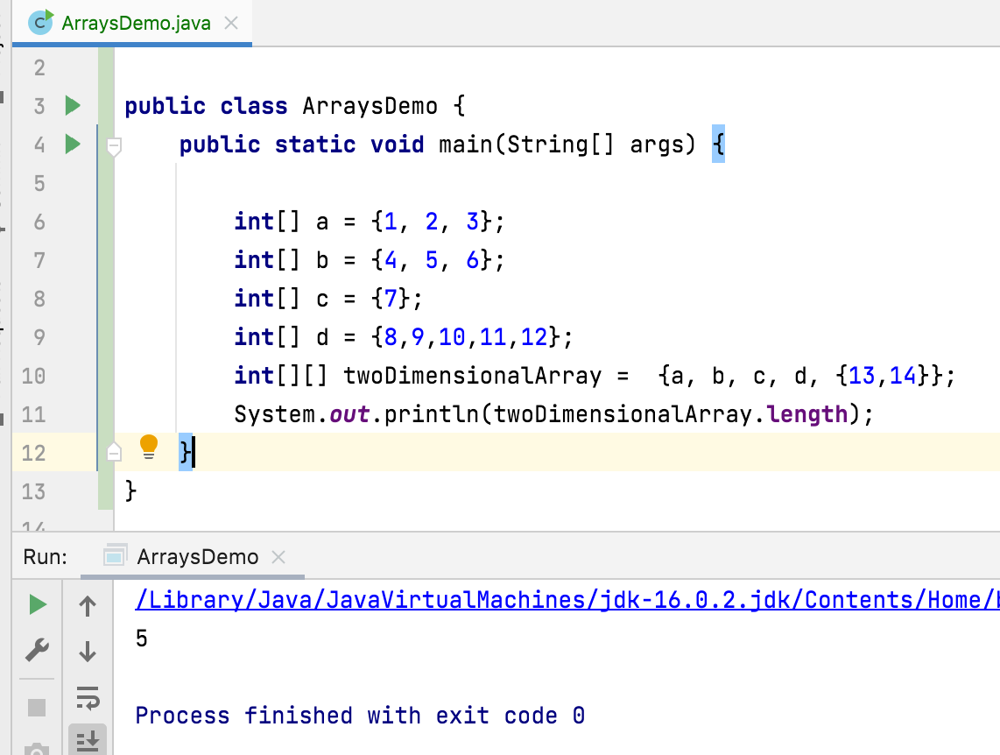

Slide 7
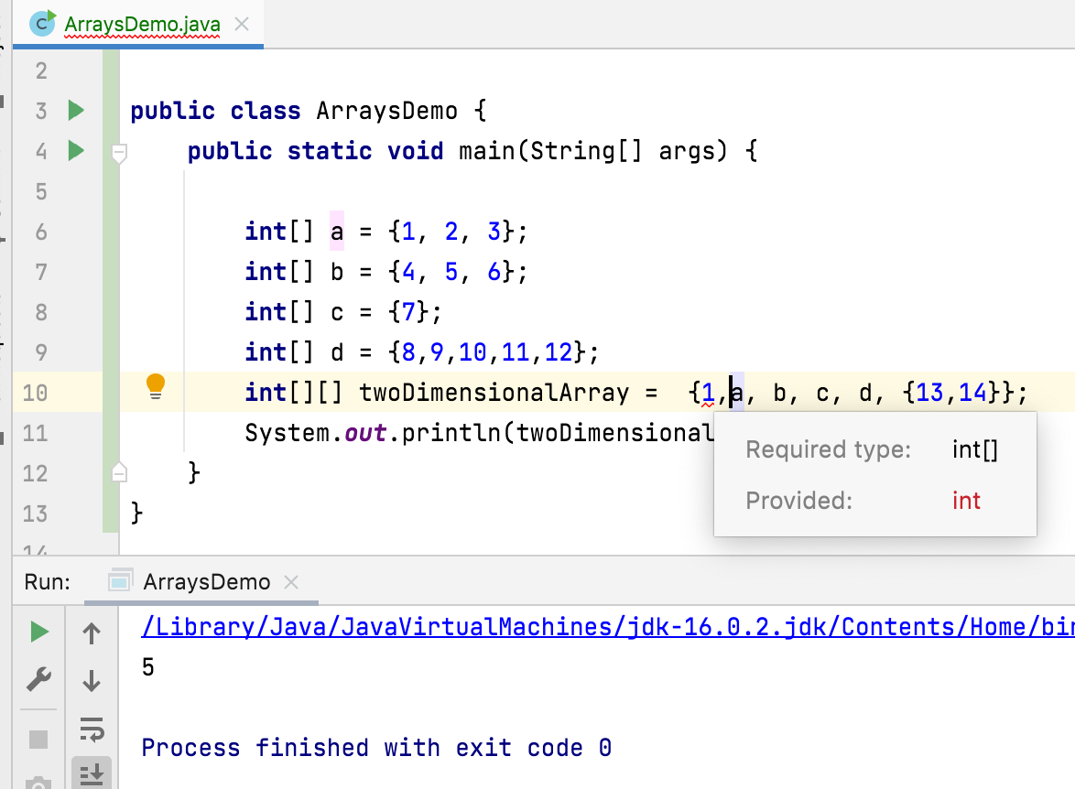

Slide 8











How Are the Arrays(2D) stored in the memory
int[] a = {1, 2, 3}; int[] b = {4, 5, 6}; int[] c = {7}; int[][] twoDimensionalArray = {a, b, c};
twoDimensionalArray
twoDimentionalArray[0 ][0 ]
twoDimentionalArray[1 ][1 ]

Slide 9
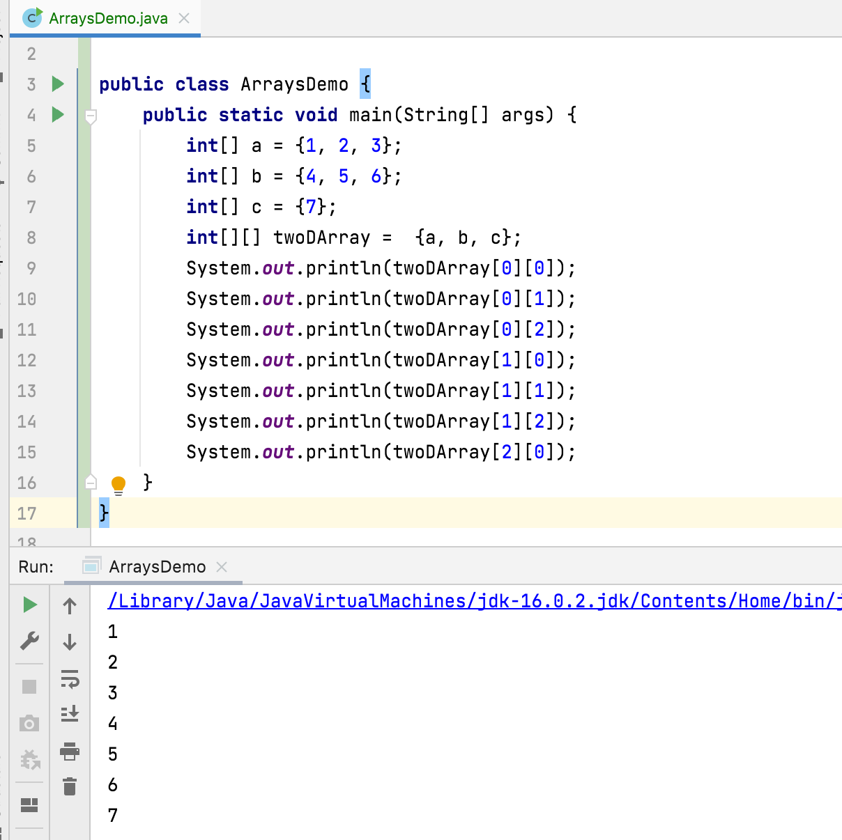

Slide 10
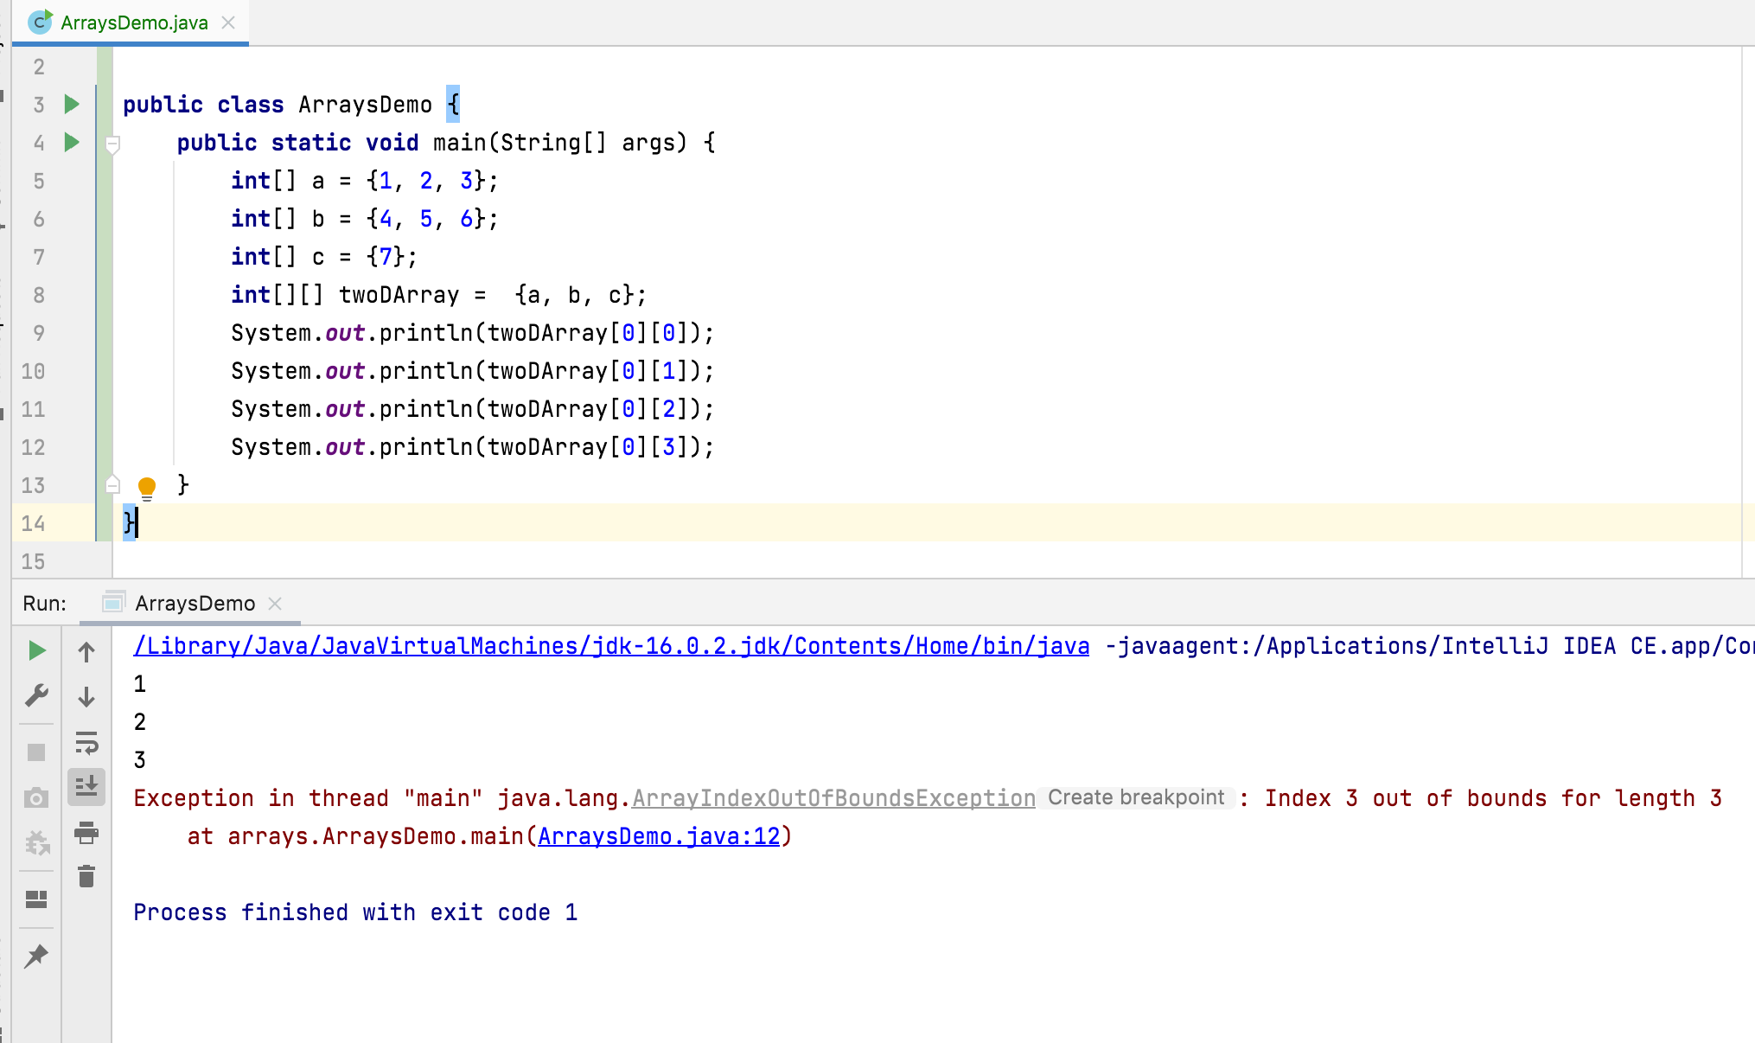

Slide 11
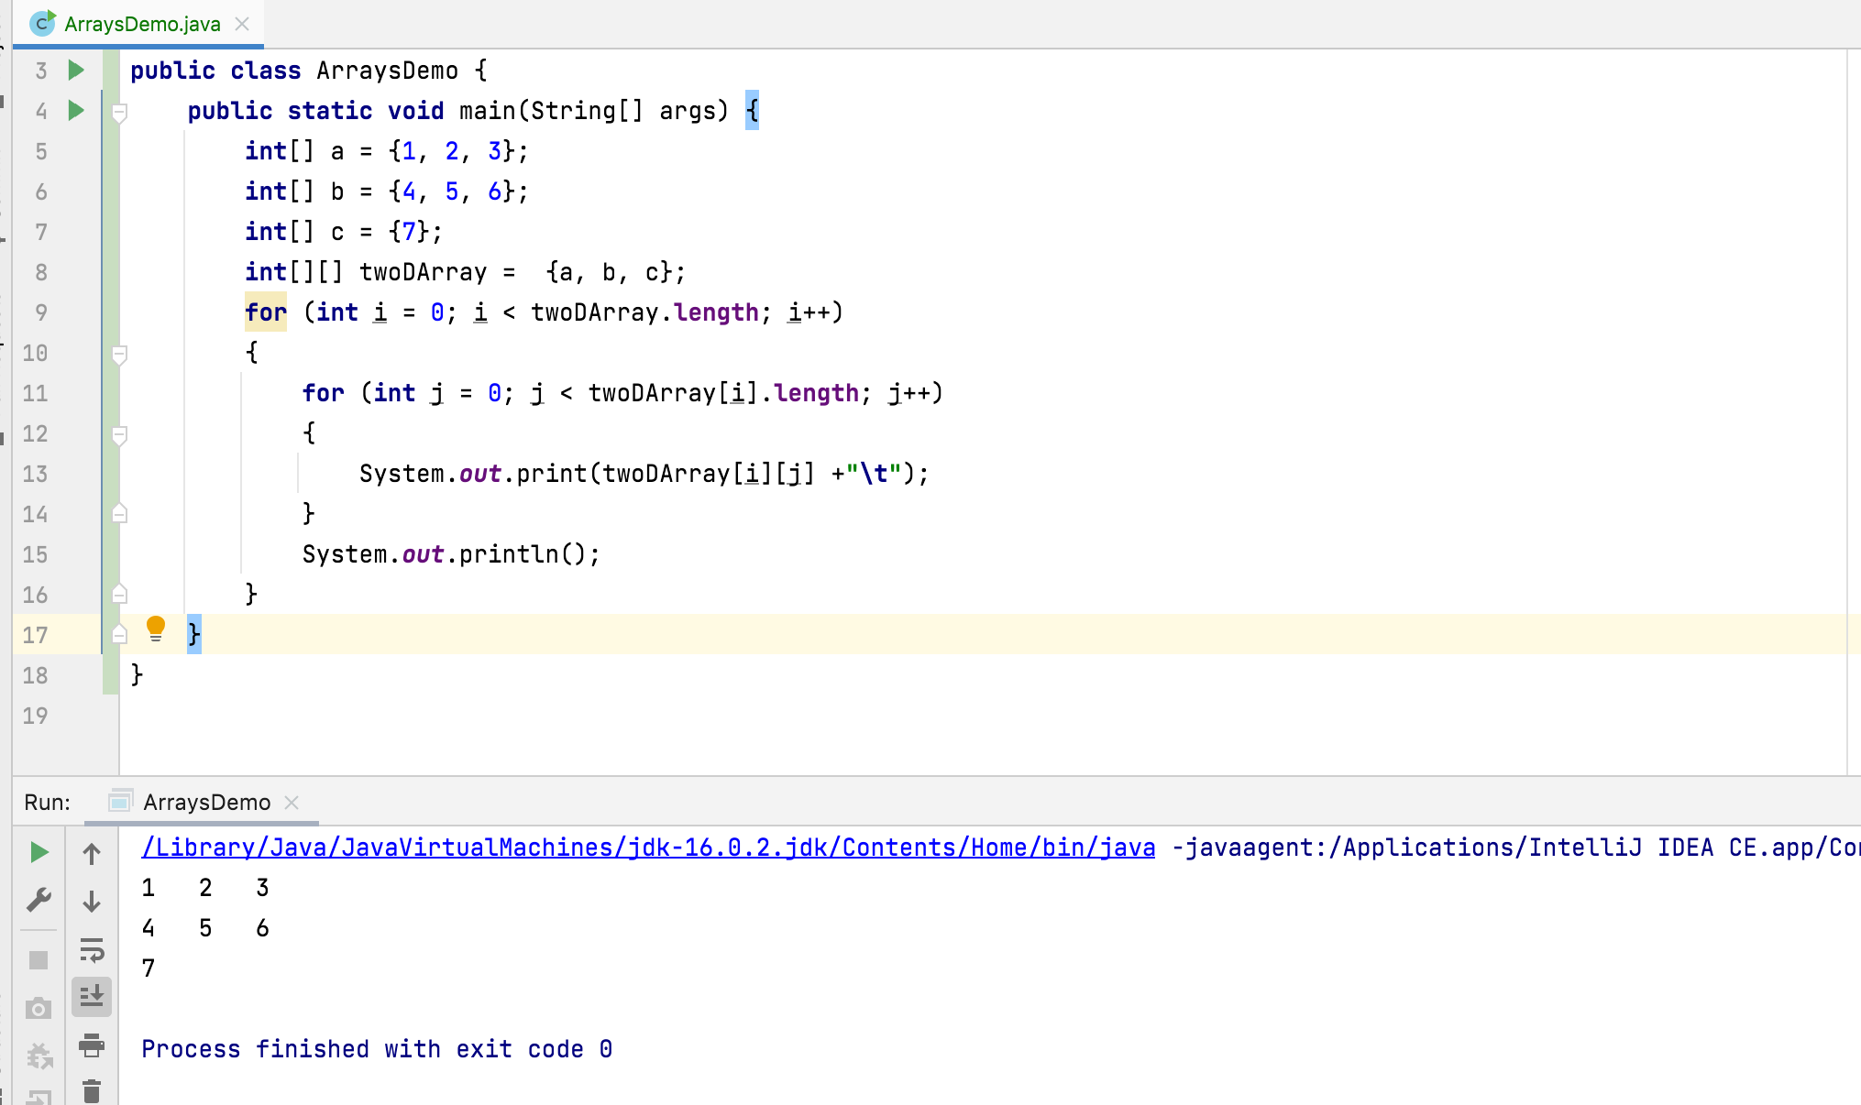

Slide 12
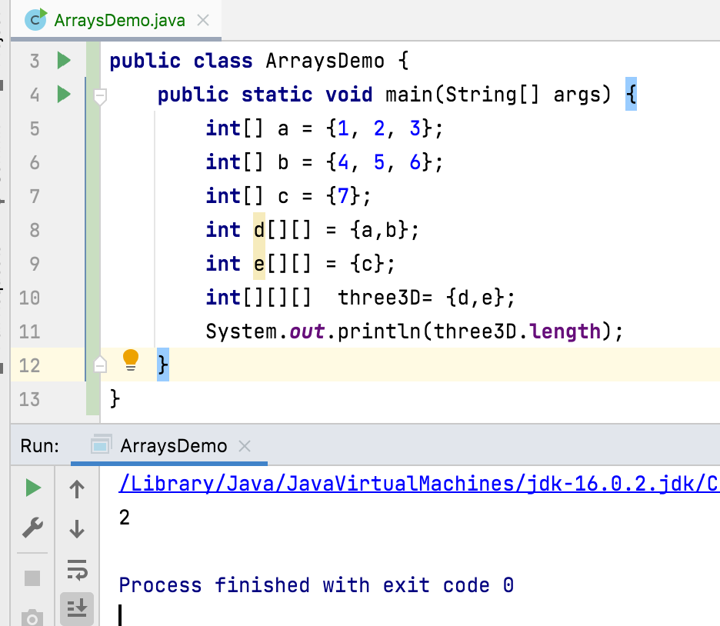
Three-Dimensional Array :
Three-dimensional array is an array containing references of two-dimensional array
int[][][] a = new int[3][3][3]; int[] b[][] = new int[3][][]; int c[][][] = new int[2][][];

Slide 13















int[] a = {1, 2, 3};int[] b = {4, 5, 6};int[] c = {7}; int d[][] = {a,b}; int e[][] = {c}; int[][][] three3D= {d,e};
three3D
three3D[1][0][0]

Slide 14
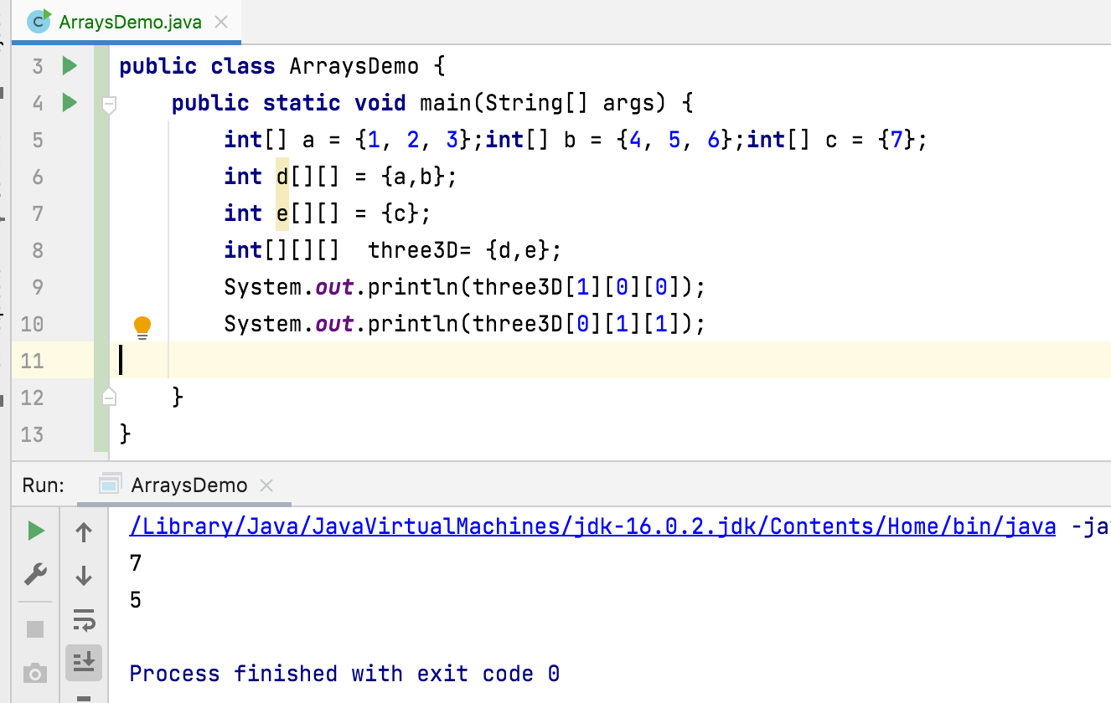

Slide 15
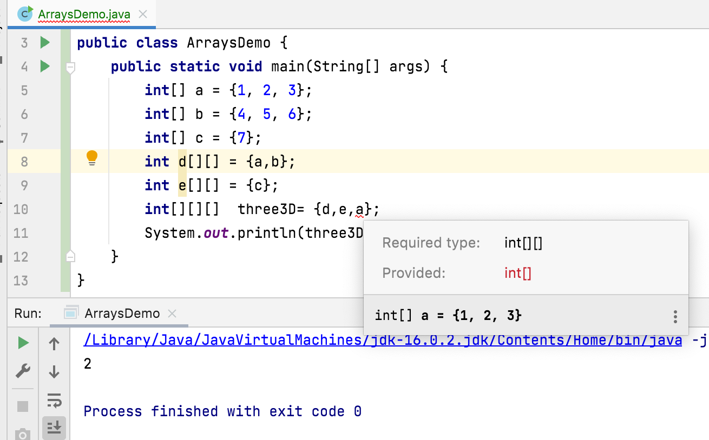

Slide 16
Thank You !
momedaram

